Slide 1

CPS 3 (HO-18-C007)
The Effect of Fenestration System on Building Daylighting and Solar Radiation
An Experimental Study in Humid Subtropical Climate
Joseph Rendall
Texas A&M University - Kingsville
joseph.rendall@ students.tamuk.edu

Slide 2
Learning Objectives
Provide the measured data of heating and cooling for residential community in Hot Summer and Cold Winter Zone of China.
Explain the influence factor for the heating or cooling demand of residential buildings.
Describe trends among window size/orientation, sun angle, and indoor daylighting/temperature metrics.
List current challenges in researching/designing buildings for lighting and thermal comfort posed by sunny climates.
Evaluate overheating in free-running buildings according to the adaptive thermal comfort theory as proposed by current ASHRAE guidelines.
Understand how indoor temperature in free-running buildings can be forecasted using regression analysis

Slide 3
Acknowledgements
The authors would like to thank:
Dr. Hua Li and Dr. Kai Jin and the TAMU-K IR-SEED REU program for research support and funds
National Science Foundation for research funds
Mechanical Measurements Lab and research facilities at TAMU-K Mechanical Engineering department and travel funds
HERE work force development program managed by ORISE at Oak Ridge National Laboratories for travel funds
This study was funded by the National Science Foundation (NSF, EEC-1359414). Any opinions, findings or recommendations expressed in this poster were created by authors and not reviewed by nor necessarily reflect the views of NSF.

Slide 4
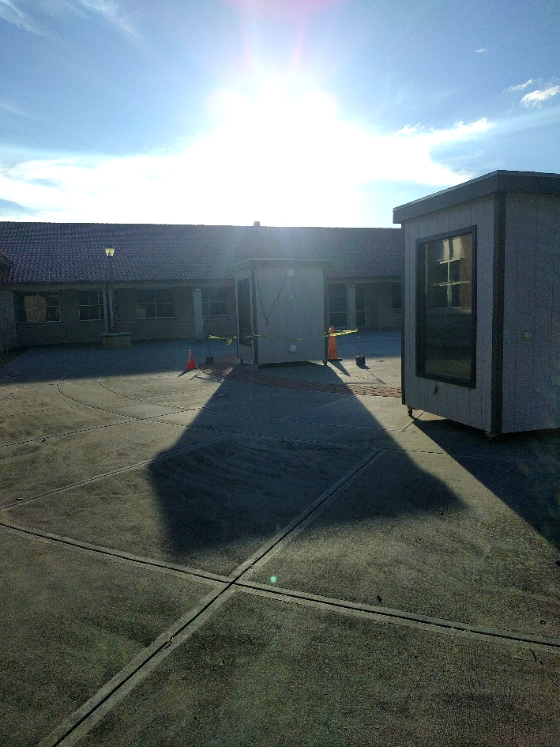
Outline/Agenda
Motivation
Experimental Methodology
Preliminary Results
Future Studies

Slide 5
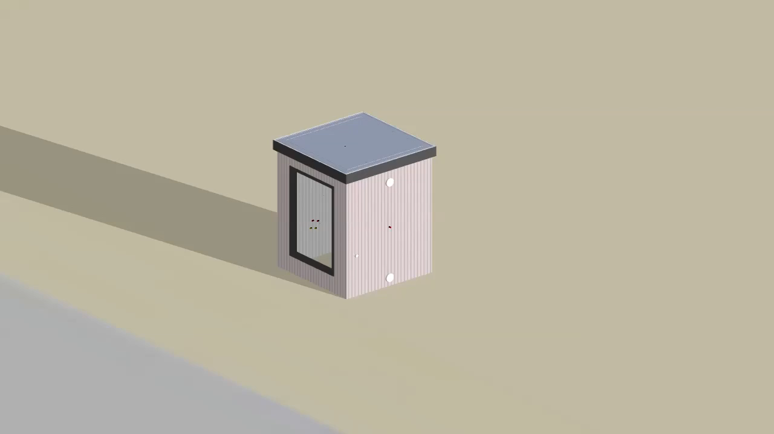
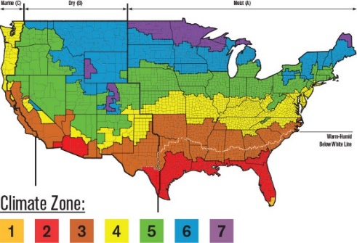
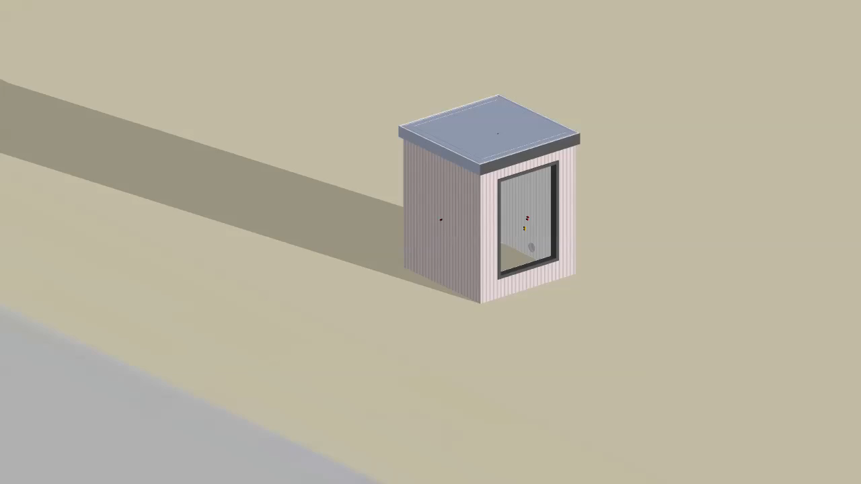
Motivation
Optimize visual comfort vs. building energy consumption (EIA 2017)
Expand-on previous research to hot & humid climates (Shen & Tzempelikos 2012)
Validate future simulations as TMY data is limiting (Reinhart 2012)
South-Facing in SE Texas
East-Facing in SE Texas
Notes:
Validation increasingly important as computational simulation tools become more widespread
41% of US energy consumption is used in buildings, including for air conditioning (EIA 2017).
Need to extend and to verify results of past research on different climate settings (Shen & Tzempelikos 2012), uncertain weather conditions (Herrera et al. 2017), complex building systems (Cannon-Brookes 1997), and the sensitivity of simulations to chosen initial parameters (Reinhart & Davila, 2016; Shen & Tzempelikos 2013).
According to Reinhart (2012), “many simulations find TMY not stringent enough to meaningfully test the performance of a building under extreme weather conditions such as heat waves.”

Slide 6
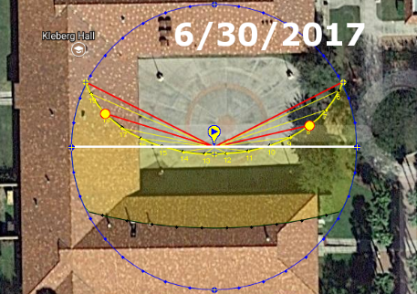
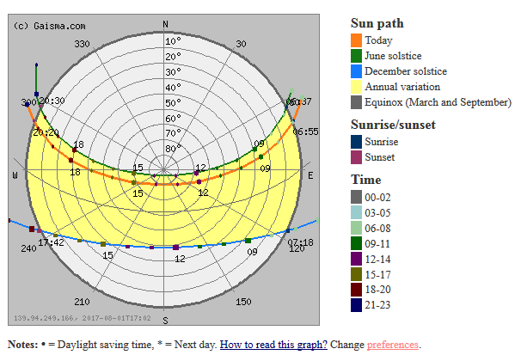
Methodology: Sun path diagrams and UDI
Sun rises north of straight E-W and only peaks into southern hemisphere at this latitude in the summer

Slide 7
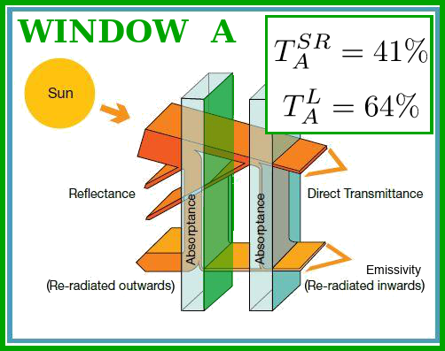
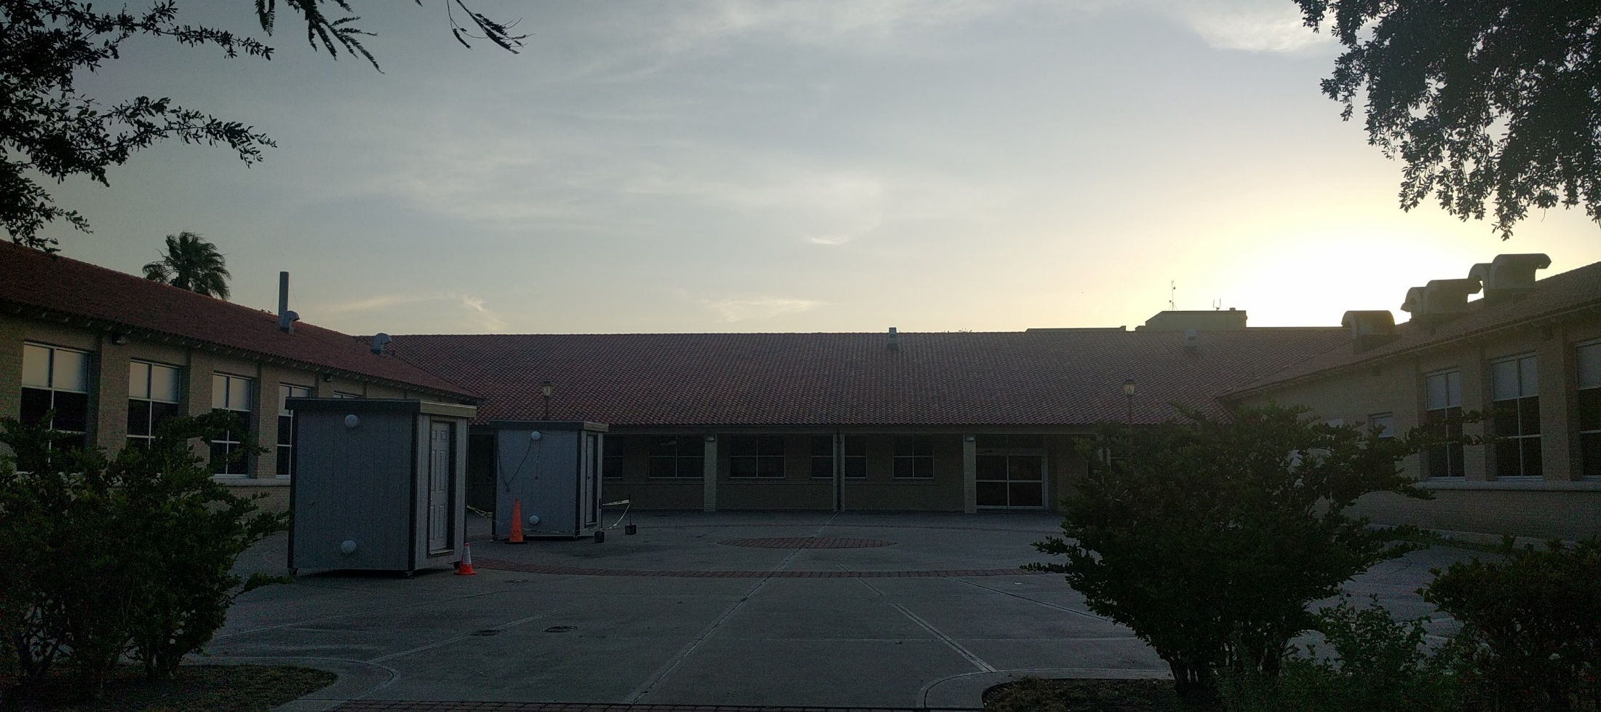
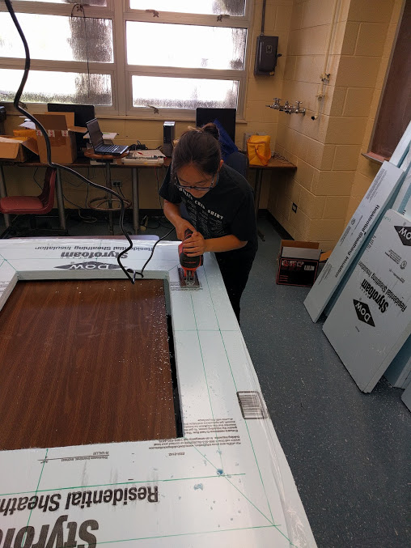
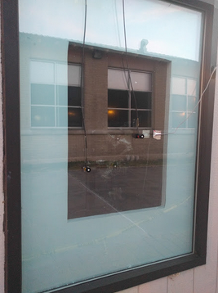
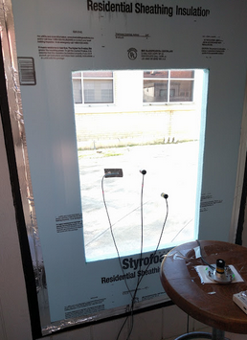
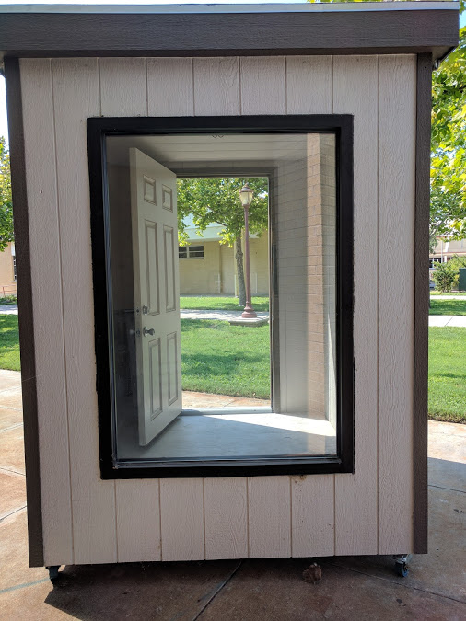
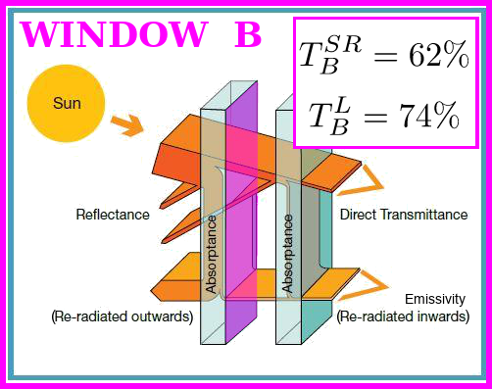
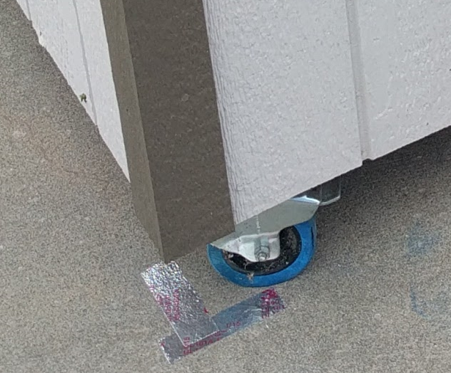
Methodology: Experiment Settings
Test House B
4 Sizes
Test House A
7 combinations of orientation and size
4 Orientations
2 Types
Figure: Window Transmittance.
Diagram adapted from https://www.pilkington.com/en-gb/uk/architects/types-of-glass/solar-control-glass/how-it-works

Slide 8
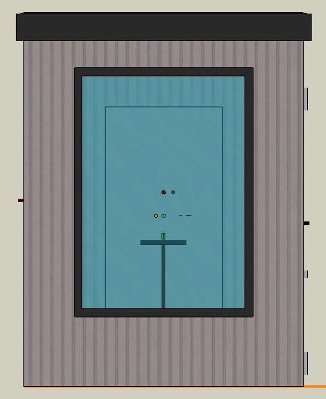
Methodology: Experimental setup
Data collected | → | Metrics calculated
Light Level | → | Light Transmittance Useful Daylight Illuminance Solar Energy Gain
Solar Radiation | → | Solar Transmittance Solar Energy Gain Cooling Load
Temperature | → | Temperature distribution Heat Transfer

Slide 9
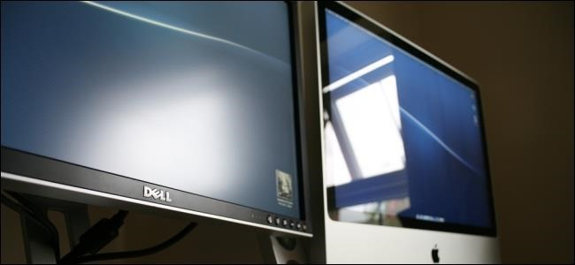
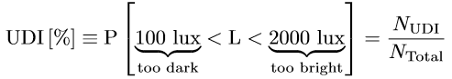
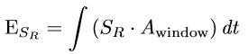
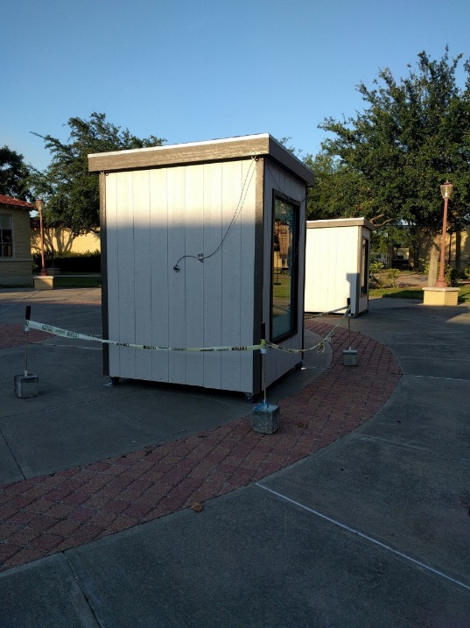
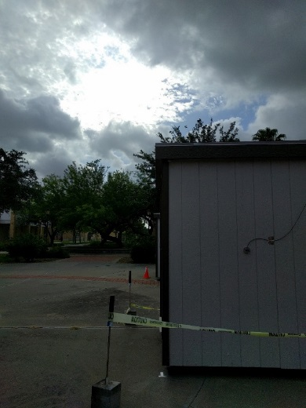
Methodology: Metrics for Analysis
Useful Daylight Illuminance (UDI)
Solar heating gain
Clearness Index (K_{t})
Cloud cover is one example of an uncontrollable weather variable

Slide 10
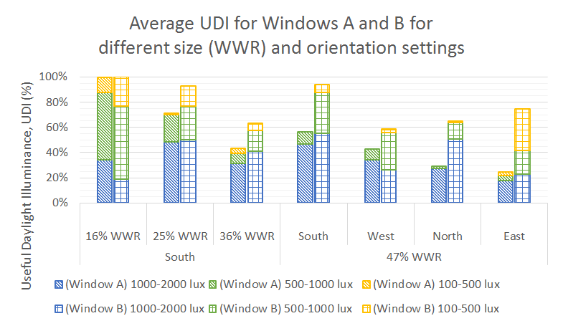
Results: Useful Daylight Illuminance (UDI)

Slide 11
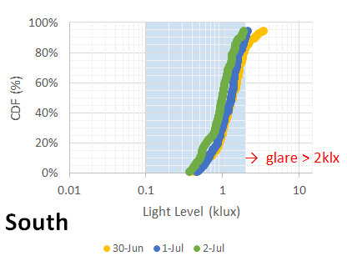
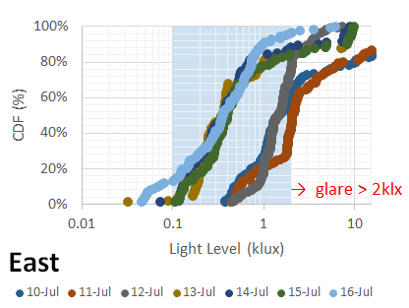
Results: Sensitivity of UDI
East and West orientations poor UDI performance.
Glare (>2 klux) was the primary problem.
Good Levels
Good Levels
Too Dark
Too Dark

Slide 12
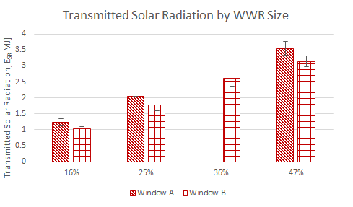
Results: Transmitted Solar Radiation

Slide 13
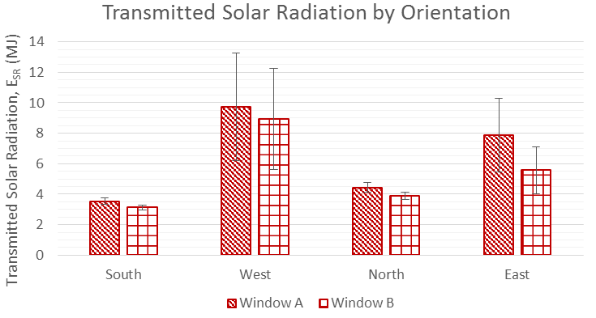
Results: Transmitted Solar Radiation

Slide 14
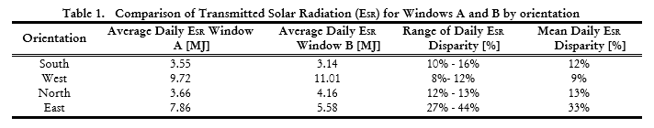
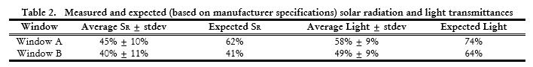
Results: Window Transmittance

Slide 15
Results: Weather
Clearness index allowed for reduced experiment time
Thermal analysis requires conditioning and another metric

Slide 16
Assumptions and Limitations
Preliminary study for test houses and sensors.
Small room size affects thermal convection and light reflection.
Results limited to summer season.

Slide 17
Future Studies
UDI Threshold sensitivity analysis
Data collection in other seasons
Thermal analysis of radiation heat gain
Advanced windows will be installed

Slide 18
Conclusions
Test cells mounted on wheels and foam inserts used to vary window settings without replacing window.
Optimal setting for summer in SE Texas 16% WWR and South-facing orientation.
Additional experiments are required

Slide 19
Bibliography
Cannon-Brookes, S. W. A. "Simple scale models for daylighting design: Analysis of sources of error in illuminance prediction." International Journal of Lighting Research and Technology 29, no. 3 (1997): 135-142.
EIA, US. "Monthly energy review." Energy Information Administration, US (2017). Retrieved August 03, 2017, from https://www.eia.gov/.
Herrera, Manuel, Sukumar Natarajan, David A. Coley, Tristan Kershaw, Alfonso P. Ramallo-González, Matthew Eames, Daniel Fosas, and Michael Wood. "A review of current and future weather data for building simulation." Building Services Engineering Research and Technology (2017): 0143624417705937.
HOMER Pro 3.9. How HOMER Calculates Clearness Index. (n.d.). Retrieved July 10, 2017, from http://www.homerenergy.com/support/docs/3.9/how_homer_calculates_clearness_index.html
NOAA ESRL GMD. NOAA Solar Position Calculator Details. (n.d.). Retrieved August 6 2017 from https://www.esrl.noaa.gov/gmd/grad/solcalc/calcdetails.html.
Reinhart, Christoph F. 4.430 Daylighting Lecture 2: The Source [PDF of Powerpoint slides, Page 27, Slide 54]. (2012). Retrieved June 20, 2017, from https://ocw.mit.edu/courses/architecture/4-430-daylighting-spring-2012/lecture-notes/MIT4_430S12_lec02.pdf
Reinhart, Christoph F., and Carlos Cerezo Davila. "Urban building energy modeling–A review of a nascent field." Building and Environment 97 (2016): 196-202.
Stephanie Chin, Joseph Rendall, Xiaoyu Liu, Hui Shen. 2018. The Effect of Fenestration System on Building Daylighting and Solar Radiation: An Experimental Study in Humid Subtropical Climate. Presented at the 2018 ASHRAE Annual Conference, June 23-27.
Shen, Hui, and Athanasios Tzempelikos. "Daylighting and energy analysis of private offices with automated interior roller shades." Solar energy 86, no. 2 (2012): 681-704.
Shen, Hui, and Athanasios Tzempelikos. "Sensitivity analysis on daylighting and energy performance of perimeter offices with automated shading." Building and environment 59 (2013): 303-314.

Slide 20
Questions?
Stephanie Chin, schin19@mit.edu
Joseph Rendall, joseph.rendall@students.tamuk.edu
Dr. Xiaoyu Liu, xiaoyu.liu@tamuk.edu
Dr. Hui Shen, hui.shen@tamuk.edu

